Slide 1
NXP Connectivity Solution
General Overview
Feb 2016

Slide 2
Kinetis 2.4GHz Wireless Connectivity Portfolio
SW Stacks
Thread
BLE 4.1
BLE 4.2
Performance, Integration
Development
phase
KW22D
CM4 50MHz
512kB/64kB
KW41Z
CM0+ 48MHz
Up to 512kB/128kB
Concept
KW22D
CM4 50MHz
512kB/64kB
Planning
KW21D
CM4 50MHz
512kB/64kB
KW31Z
CM0+ 48MHz
Up to 512kB/128kB
Execution
Higher Performance Radio
Increased Memory Size
Production
KW21D
CM4 50MHz
256kB/32kB
KW21Z
CM0+ 48MHz
Up to 512kB/128kB
KW40Z
CM0+ 48MHz
160kB/20kB
Wireless
Transceiver
KW30Z
CM0+ 48MHz
160kB/20kB
BLE & 802.15.4
BLE
KW20Z
CM0+ 48MHz
160kB/20kB
802.15.4
MCR20A
802.15.4
Transceiver
Existing
1H
2H
2016

Slide 3
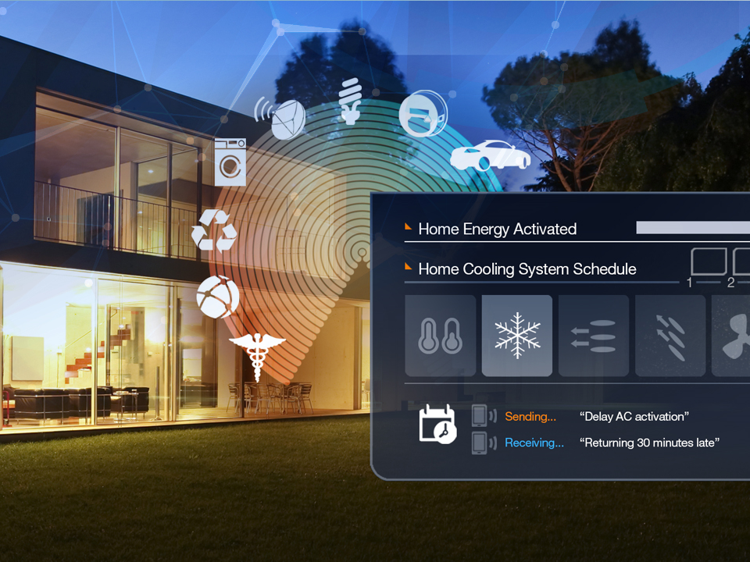
Addressing the Need for Secure, Connected Solutions

Slide 4
Critical Attributes
Security
Driving enhanced protection for customer IP and end customer personal information with standard on-chip cryptographic accelerators and industry-leading security mechanisms
Connectivity
Improving customer time to market with rapid and easy prototyping and development tools and software (RTOS, SDK, Design Studio IDE), turnkey designs and strategic ecosystem
Low-Power
Leading innovation with an optimized ultra-low-power architecture designed for maximum flexibility with efficient ARM® cores, low-power boot capabilities, smart peripherals and various power modes

Slide 5
Selection Criteria for Connectivity
Range
Many applications have a prerequisite that forces the selection of the frequency spectrum. Home automation is a great example of an application domain where there is no ‘one size fits all’!
Network Topology
Point-to-point is simple. A star configuration can benefit to the power consumption of the entire system. A mesh can enable a great number of connections. A combination of everything can be a real challenge!
Protocol
Selecting a new protocol can be the right thing to do technically. Now other commercial considerations have their words to say.

Slide 6











Diversity of Connectivity Solutions
Application Layer /
Profiles
HomeKit
AllJoyn
IoTivity
IPSO
M2M
MQTT
Remote Controls (ZRC)
Home Automation (HA1.2)
Light Link (ZLL)
Smart Energy (SE1.x)
Bluetooth
Host Stack
TCP / UDP
6LoWPAN
IPv4 / IPv6
RF4CE
ZigBee PRO
Network Layer /
Transport Layer
Physical / Link Layer
(PHY/MAC)
Bluetooth
Link Layer
IEEE 802.11n
(high data rate networking)
IEEE 802.15.4e
IEEE 802.15.4 (low power networking)
Wearables
Gateways
Border Routers
Sub-1 GHz
Industrial Wireless
2.4 GHz Home Automation &
Control Networks

Slide 7
Megatrends that are Visible Today
Opportunities
Challenges
Multi-protocol solutions
Radio co-existence (HW)
New interaction with the user
Communication co-existence (SW)
Power scheme optimization
Blind spots
Adding new security schemes
Lack of standards for IoT
Move to IP-based networks
Compatibility with legacy products
Connecting to the cloud
Ecosystem to enable seamless integration

Slide 8
Freescale Strategy and Vision
Differentiate through Software
Deliver all our software integrated in the Kinetis environment
Deliver all our software packaged with FreeRTOS and MQX
Optimize our PHY/MAC, network & transport layers
Deliver Compelling SoC based Solutions
Implement complete convergence between our MCU and Connectivity products
Deliver solutions for 2.4GHz and sub-1GHz, Narrow-Band and WiFi
Focus on multi-protocol devices
Provide a Complete Development Environment
Re-use our MCU experience to deliver outstanding support
Create best-in-class connectivity tools and ref. designs
Work with partners when Freescale does not have the best offer

Slide 9
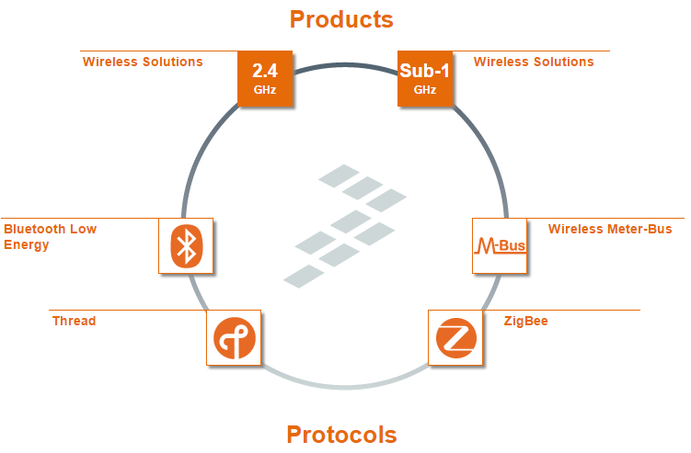
Wireless Connectivity HomePage http://www.freescale.com/webapp/sps/site/homepage.jsp?code=WIRELESS-CONNECTIVITY

Slide 10
IEEE 15.4 - 2.4 GHz DSSS
Notes:
So… Why Thread

Slide 11
Kinetis 2.4GHz Wireless Connectivity Portfolio
SW Stacks
Thread
BLE 4.1
BLE 4.2
Performance, Integration
Development
phase
KW22D
CM4 50MHz
512kB/64kB
KW41Z
CM0+ 48MHz
Up to 512kB/128kB
Concept
KW22D
CM4 50MHz
512kB/64kB
Planning
KW21D
CM4 50MHz
512kB/64kB
KW31Z
CM0+ 48MHz
Up to 512kB/128kB
Execution
Higher Performance Radio
Increased Memory Size
Production
KW21D
CM4 50MHz
256kB/32kB
KW21Z
CM0+ 48MHz
Up to 512kB/128kB
KW40Z
CM0+ 48MHz
160kB/20kB
Wireless
Transceiver
KW30Z
CM0+ 48MHz
160kB/20kB
BLE & 802.15.4
BLE
KW20Z
CM0+ 48MHz
160kB/20kB
802.15.4
MCR20A
802.15.4
Transceiver
Existing
1H
2H
2016

Slide 12
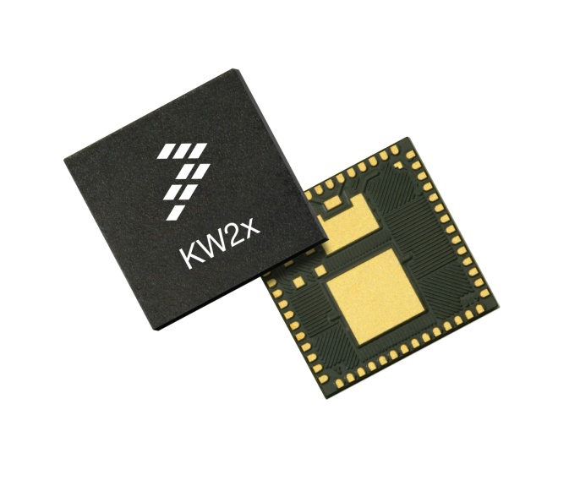
What is Kinetis KW2x MCU?
The new Kinetis KW2x MCU is Freescale’s next generation 2.4 GHz 802.15.4 platform
The Kinetis KW2x platform integrates a class leading RF transceiver, ARM® Cortex®-M4 core and a robust feature set for a reliable, secure and low-power IEEE® 802.15.4 wireless solution.
Wireless protocol software is seamlessly integrated into Kinetis software development tools for rapid creation of embedded systems.

Slide 13
MKW2xD Block Diagram (Mohave)
Core Features
50 MHz Cortex M4 CPU core
Up to 512KB Flash & up to 64KB SRAM
Typical current: 250 uA/MHz run, 1.7uA RTC standby
RF Features
2.4 GHz frequency ISM band, including MBAN
-102dBm receive sensitivity
Up to + 8dBm programmable output power
TX 17mA at 0dBm and RX 19mA typical
Cryptography: DES, 3DES, AES 128-256, SHA-1, SHA-256, MD5, RNG
Active and passive tamper detection
Dual-PAN support (personal area network)
Fast antenna diversity supporting 2 antennas
Low component count for Balun & Match
System Features
-40 °C to 105 °C
1.8 to 3.6 V
8x8 Laminate QFN 63-pin
Core
System
Memories
RF Transceiver
ARM CortexTM-M4
50 MHz
Internal and External Watchdogs
Program Flash
(Up to 512 KB)
IEEE 802.15.4 2006
2.4 GHz
DSP
DMA
FlexMemory Option
64 KB FlexNVM
4 KB FlexRAM
(MKW21D256 only)
Fast Antenna Diversity
Low Leakage Wake-Up Unit
Debug Interfaces
Dual PAN ID
Interrupt Controller
Analog
SRAM
(Up to 64 KB)
32 MHz Osc
16-bit ADC
SPI Interface
Communications
High Speed Comparator with
6-bit DAC
Timers
I²C
Flex Timer
Clocks
SPI
Security
Programmable Delay Block
Phase-Locked Loop
UART (ISO 7816)
Cyclic Redundancy Check (CRC)
Periodic Interrupt Timers
Frequency Locked Loop
USB On-The-Go (H)
Tamper Detect
Cryptography Authentication Unit
Low Power Timer
Low / High Frequency Osc.
USB Charger Detect
USB Voltage Regulator
Random Number Generator
Independent Real Time Clock
Internal Reference Clocks
High performance 2.4 GHz 802.15.4 transceiver
Notes:
Freescale Semiconductor’s second-generation ZigBee® compliant platform combines an IEEE® 802.15.4-compliant radio and an 8-bit MCU into a 9 x 9 x 1 mm 64-pin LGA package
The MC1321x Family encompasses a series of devices that are memory scalable to fit the needs of the application. Each device includes a Freescale MC9S08GT-based MCU with up to 60 KB of Flash and 2.4 GHz 802.15.4 transceiver.
Regardless of the application’s requirements, which may range from simple point-to-point connectivity to ZigBee mesh networks, the MC1321x devices scale to meet them.

Slide 14
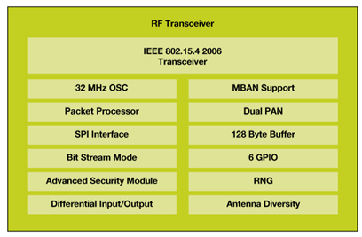
Transceiver Features
Transceiver Features
2.4 GHz frequency band
Supports 2.36 to 2.4 GHz Medical Band
802.15.4 compliant
250 kbps data rate
O-QPSK modulation
DSSS with 5 MHz channels
16 selectable channels
Supports packet and bit stream mode
802.15.4 Packet Processor
Output power varience +/- 2 dBm
Programmable output power from -30 to +10 dBm
2dB steps
Low power receive mode
32 Mhz crystal oscillator with on board trim capability

Slide 15
Dual PAN
Ability to participate in two networks simultaneously
Maintains two sets of network parameters
PAN, MAC address (short and long), Channel
2 channels, 2 PANs
Manual mode – software controls which PAN is active
Automatic mode – hardware controls which PAN is active
Time to dwell on channel can be set from .5 mS to 3.2 seconds
If PAN is active when timer expired, sequence will complete before channel switch occurs
Channel switch is 56 uS
Time to switch, poll, receive packet and switch back is <10mS
1 channel, 2 PANs
Address filtering is done simultaneously
No channel switch is necessary
 |  |  |  |  |  |  |  |  |  |  |  |  |  |  |  |  |  |  |  |  |  |  |  |  |  |  |  |  |  |  |  |  |  |  |  |  |  |  |  |  |  |  |  |  |  |  |  |  |  |  |  |  | Preamble |  | 802.15.4 Packet (PAN 1) | Sequence Idle
Channel Switch |  |  |  | Preamble Search PAN 2 |  |  |  |  |  |  |  |  |  |  |  |  |  |  |  |  |  |  |  |  |  |  |  |  |  |  |  |  |  |  |  | Channel Switch |  |  |  | Preamble Search PAN 1 |  |  |  |  |  |  |  |  |  |  |  |  |  | Active PAN 1 |  | Channel Switch | Preamble Search PAN 2
Dual Channel Example

Slide 16
Features and Benefits
Features | Benefits
RF
Class-leading link budget | 112 dB link budget provides greater range, reducing the need for external power amplifiers and lowering cost.
Low power consumption | 17mA TX / 19 mA RX power consumption extends battery life
Dual PAN support | System can actively participate in 2 networks, eliminating the need for multiple radios.
Diversity Support | Freescale’s FAD (Fast Antenna Diversity) allows the hardware to automatically select between 2 antennas, improving reliability in high interference environments.

Slide 17
Features and Benefits
Features | Benefits
MCU
ARM® Cortex™-M4 core with DSP | Up to 50 Mhz core provides a broad range of application support
Up to 512 KB of Flash and 64 KB of RAM | Provides enough memory to run complicated protocols or dual stacks and user applications on a single IC
256 KB of FlexMemory (MKW21 only) | Allows user to define configuration of memory between Flash and EEPROM
Secure Flash | Protects the code and data from unauthorized access or modification
Tamper detect | Protects critical IP by detecting tamper events (NDA required)
Cryptography Acceleration Unit | Reduces code size and execution time through hardware support for advanced security protocols
128-bit Random Number Generator | Meets the FIPS 140 Security Requirements for Cryptographic Modules

Slide 18

Kinetis KW2x MCU Radio Power Modes
Mode | Definition | Idd @ 3.0V and 25C
Transmit | Radio transmitter on @ 0 dBm, crystal oscillator on, SPI active | 18 mA
Receive | Radio receiver on at -102 dBm, crystal oscillator on, SPI active | 19.5 mA
LPPS | Low power preamble search – Radio actively listening looking for preamble, transitions to full Receive when found. | 15 mA
Hibernate | Radio low power mode, crystal oscillator off, SPI functional | < 1 µA
Reset | Radio in reset | <100 nA
RADIO
Note: Radio power modes operate independent of MCU power modes
Notes:
The second pillar is having several, flexible ultra-low power modes (see slide for details). Kinetis L-Series goes beyond the 3 traditional power modes: RUN, SLEEP, and DEEP SLEEP and gives the user finer options that are designed to maximize battery life in varying applications. As you go down the deep sleep modes the MCU begins to power gate more logic and memory and also reduce the energy saving peripheral functionality.

Slide 19
Kinetis KW2x MCU Power Modes
Mode | Definition | Idd @ 3.0V and 25C
Run | 50 MHz core and system clock, 25 MHz bus and flash clock, code executing from flash, all peripheral clocks enabled. | 17 mA
VLP Run (VLPR) | 4 MHz core, system and bus clock, 1 MHz flash clock. All peripheral clocks enabled All peripheral clocks disabled | 754 µA 1.1 mA
Wait | Allows all peripherals to function, while CPU goes to sleep reducing power consumption. No Compute Operation clocking option. All peripheral clocks disabled. High frequency (50 MHz core, 25 MHz bus and flash clock) Reduced frequency mode (25 MHz core, 25 MHz bus clock, 12.5 MHz flash clock) | 7.95 mA 5.88 mA
VLP Wait (VLPW) | Similar to VLP Run, with CPU in sleep to further reduce power. No Compute Operation clocking option. All peripheral clocks disabled. | 437 µA
Stop | MCU is in static state. Lowest power mode that retains all registers while maintaining LVD protection. | 320 µA
VLP Stop (VLPS) | MCU is in static state with LVD operation off. Lowest power mode with ADC, LPT, RTC, LCD, HSCMP, DAC, and pin interrupts functional. | 7.33 µA
LL Stop (LLS) | MCU is in low leakage state retention power mode. LLWU controls wakeup sources including LPT, RTC, LCD, HSCMP, DAC and select pin interrupts. | 3.14 µA
VLL Stop 3 (VLLS3) | MCU is placed in a low leakage mode powering down most internal logic. All system RAM contents are retained and I/O states held. LLWU controls wakeup sources including LPT, RTC, LCD, HSCMP, DAC and select pin interrupts. | 2.19 µA
VLL Stop 2 (VLLS2) | Similar to VLL Stop 3, with only partial system RAM retention. FlexRAM contents can optionally be retained. | 1.77 µA
VLL Stop 1 (VLLS1) | Similar to VLL Stop 3, with only 32 byte register file retention. | 1.03 µA
VLL Stop 0 (VLLS0) | Lowest power mode. Similar to VLL Stop 1, 32 byte register file retention only. LLWU, RTC can be operational. All SRAM powered off. Additionally, the 1kHz LPO clock is disabled. POR enabled POR disabled | 543 nA 359 nA
RUN
SLEEP
DEEP SLEEP
Notes:
The second pillar is having several, flexible ultra-low power modes (see slide for details). Kinetis L-Series goes beyond the 3 traditional power modes: RUN, SLEEP, and DEEP SLEEP and gives the user finer options that are designed to maximize battery life in varying applications. As you go down the deep sleep modes the MCU begins to power gate more logic and memory and also reduce the energy saving peripheral functionality.

Slide 20
Kinetis KW4x MCUs – Multi-Protocol Wireless SoC
Main Features
Cortex-M0+ running up to 48 MHz
Support for BLE v4.1 , 802.15.4-2011, ZigBee PRO & RF4CE, 802.15.4j-2013
160 KB Program Flash, 20KB RAM
-92 dBm in BLE mode, -102 dBm in 802.15.4 mode
-20 to +5 dBm programmable output power
13.5 mA Rx & Tx (0dBm) current target (DC-DC bypass)
7mA Rx & Tx (0dBm) current target (DC-DC enabled)
<2uA standby current
Four independently programmable DMA controller channels
AES, DES, 3DES, MD5, SHA-1, SHA-256 & NIST-complaint RNG
Full featured, highly flexible peripherals
16-bit ADC with temperature sensor and battery monitor
12-bit DAC and 6-bit High-speed Comparator
LP-SPI, LP-UART, 2xI2C, CMT, GPIO with IRQ capability (KBI)
3xFlexTimer with PWM & quadrature decode support
Low Power, Programmable Interrupt and RTC timers
Multiple power supply options
Normal: 1.8V to 3.6V
Buck : 2.1V to 3.6V for coin cell operation
Boost : 0.9V to 1.8V for single alkaline battery operation
Unique Identifiers
80-bit device ID programmed at factory
48-bit and 64-bit 802.15.4 MAC address programmed at factory
-40ºC to +105ºC
Core
System
Memories
BLE Radio
ARM CortexTM-M0+
48 MHz
Internal and External Watchdogs
160 KB
Program Flash
802.15.4 & BLE 4.1 radio
Interrupt Controller
DMA
Baseband IP
Low Leakage Wake-Up Unit
20 KB SRAM
Debug Interfaces
DC-DC Converter
Analog
PA / LNA
16-bit ADC
Timers
Control Registers
Communications
Flex Timer
12-bit DAC
2 x I2C
Programmable Delay Block
Clocks
Security
Phase-Locked Loop
SPI
Cyclic Redundancy Check (CRC)
Periodic Interrupt Timers
Frequency Locked Loop
UART
Cryptography Authentication Unit
Low Power Timer
Low / High Frequency Osc.
GPIO w/ IRQ Capabilities
Random Number Generator
Independent Real Time Clock
Internal Reference Clocks
Device | Protocol | Package
MKW20Z160VHT4/R | 802.15.4/ZigBee | 7x7 48-pin LGA
MKW41Z160Vxx4/R MKW41Z160VHM4/R MKW41Z160VHT4/R | BLE & 802.15.4/ZigBee | ~3x3 xx-pin CSP 5x5 32-pin LGA 7x7 48-pin LGA
Features | Description
Software and Protocol Stacks | BLE Stack & Profiles ZigBee RF4CE & PRO & Profiles
Availability (subject to change) | Samples 2H14 Production 1Q15
Preliminary – Features and performance are subject to change

Slide 21
IEEE 15.4 – Sub GHz FSK
Notes:
So… Why Thread

Slide 22
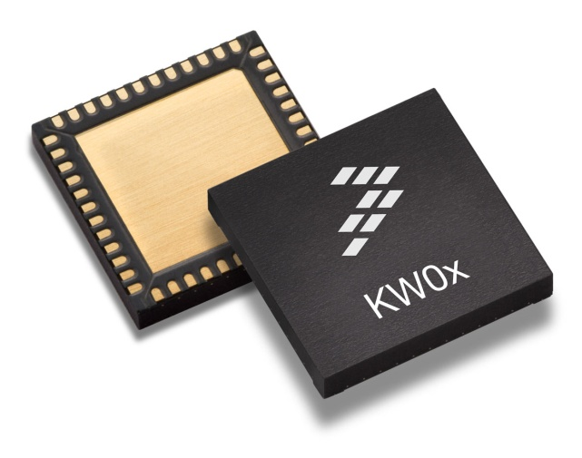
What is Kinetis KW0x MCU?
World’s first integrated ARM® Cortex®-M0+ based sub-1 GHz smart radio
Integrates Kinetis MCU (ARM Cortex M0+ 128KFlash/16K RAM) with a sub 1 GHz transceiver
Targeted for automated meter reading and mesh-networked smart sensors applications

Slide 23

The Internet of Things: Metropolitan Area Networks (MANs)
Endless Possibilities
Street Lights
Irrigation Systems
Water/Gas/Elect Meters
Fleet Vehicles
MAN Network Characteristics:
Thousands of devices per gateway
Long distance between nodes
Many hops deep

Slide 24






Sub-1 GHz Target Applications
Metering and Building Control
Metering
Thermostats
Lighting control
HVAC unit monitors
Water heaters
Window coverings
Ceiling fan
Fire/Security
Smoke/heat sensing and monitor
Fire alarm
Room occupancy
Intruder alarms
Motion detectors
Access control
Wireless Sensors Networks
Liquid or gas flow detect and alarm
Usage data collection
Asset control (acceleration/theft)
Maintenance monitoring
Measurement data collection
Humidity monitor and control
Hazardous environment monitor
Vibration alerts
Medical/Healthcare/Wellness
Glucose monitors
Cardiac rhythm tracking
Hearing appliance remotes
Infusion pumps
Blood pressure monitoring
Pulse oximetry monitoring
Weight management monitoring
Notes:
Potential Applications

Slide 25
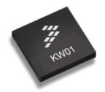

In Production - Kinetis KW01 Wireless MCU (Sub 1-GHz)
CPU
32-bit ARM Cortex M0+ 48MHz Core
128KB Flash and 16KB SRAM
Radio transceiver, Sub 1-GHz
Supports 290-344MHz, 424-510MHz, and 862-1020MHz frequency bands
FSK, GFSK, MSK, GMSK and OOK modulations up to 600kbps
Up to -120dBm Rx sensitivity @ 1.2kbps
-18 to +17dBm Tx output power in steps of 1dBm
Ultra low power for battery operated devices
Typical consumption
1.7µA standby with 4.3µs wake-up time
<50 uA/MHz CPU system run mode
16 mA Rx peak
20 mA Tx peak at 0 dBm, 33 mA at +10 dBm
Software
Simple-MAC, user modifies for their proprietary protocols
Freescale Flexible IP stack
System
16-bit ADC, Cap Touch Sensors, I2C, UART, SPI, Timers
Operating Range: 1.8V to 3.6V, -40C to +85C
Core
System
Memory
Sub-1GHz RF
ARM Cortex-M0+
48 MHz
DMA
128KB Flash
RF I/O
Interrupt
Controller
Low-Leakage
Wake Up Unit
16KB RAM
32 MHz Oscillator
RF Boost
Debug
Interfaces
Packet Engine (AES)
66-byte FIFO
Analog
Timer
Interfaces
Clock
1 x IIC
Phase-Locked Loop
16-bit ADC
2x 10-ch Timer
Analog Comparator
Peiodic Interrupt Timers
2 x UART
Frequency-
Locked Loop
1 x SPI
Frequency
Oscillators
6-bit DAC
Low Power Timer
GPIOs
Xtrinsic Touch-sensing
Internal Ref
Clocks
Device | Flash / Flex | RAM | Package
MKW01Z128CHN | 128 KB | 16 KB | 8x8 56-pin LGA
Notes:
24

Slide 26
Features and Benefits
Features | Benefits
ARM® Cortex® M0+ CPU core | Lowest power industry core
Single-chip with MCU + Radio + Memory | Save size and cost versus a 2 to 3 chip solution
High radio link budget | Very long point to point wireless range without the need for repeaters or costly amplifying devices.
Flexible RF configuration | Adapt to global standard requirements and local (regional) regulations

Slide 27
Kinetis KW01 MCU: Ultra-low Power Modes
Mode | CPU/Bus Freq. | Details | Peripheral Clocks | Typical Idd @ 3V, 25C | Recovery Time
RUN | 48/24 MHz | MAXIMUM CPU/Bus frequency. Compute clocking option SUPPORTED | ENABLED | 6.38mA (133uA/MHz) | -
 | 48/24 MHz |  | DISABLED | 4.44mA (93uA/MHz) | -
 | 48/- MHz |  | Compute Operation* | 3.98mA (83uA/MHz) | -
VLPR | 4/1 MHz | RESTRICTED CPU/Bus frequency. Compute clocking option SUPPORTED LVD OFF. Flash programming NOT supported | ENABLED | 219uA (55uA/MHz) | -
 | 4/1 MHz |  | DISABLED | 170uA (43uA/MHz) | -
 | 4/- MHz |  | Compute Operation* | 156uA (39uA/MHz) | -
WAIT | 48/24 MHz | MAXIMUM CPU/Bus frequency. CPU in SLEEP, peripherals functional. Compute clocking option NOT supported | DISABLED | 3.88mA | -
VLPW | 4/1 MHz | RESTRICTED CPU/Bus frequency. CPU in SLEEP, peripherals functional. Compute clocking option NOT supported. LVD OFF. Flash programming NOT supported | DISABLED | 112uA | 4us
STOP | - | MCU in static state, LVD ON. Energy-saving peripherals functional with ADMA. AWIC detects wake-up source for CPU. | - | 309uA | 4.3us
VLPS | - | Same as STOP mode. LVD OFF. | - | 2379nA | 4.3us
LLS | - | MCU in low-leakage state retention power mode. LLWU detects wake-up source for CPU including LPTMR, RTC, TSI, CMP, and select pin interrupts. Fast wake-up. | - | 1738nA | 4.6us
VLLS3 | - | MCU in low-leakage mode, most internal logic OFF. All RAM contents retained and I/O states held. LLWU controls wake-up source for CPU similar to LLS mode. | - | 1344nA | 53us
VLLS1 | - | Similar to VLLS3 | - | 713nA | 115us
VLLS0 | - | Pin wakeup supported. LPTMR, RTC, TSI and CMP wake-up supported with external clock. Optional POR brown-out detection circuitry. | - | 411nA (POR) / 205nA (no POR) | 115us
RUN
WAIT
(SLEEP)
STOP
(DEEP SLEEP)
*Compute Operation shuts off bus and system clock for lowest power core processing. Peripherals with an alternate asynchronous clock source can continue to operate.
Notes:
The second pillar is having several, flexible ultra-low power modes (see slide for details). Kinetis L-Series goes beyond the 3 traditional power modes: RUN, SLEEP, and DEEP SLEEP and gives the user finer options that are designed to maximize battery life in varying applications. As you go down the deep sleep modes the MCU begins to power gate more logic and memory and also reduce the energy saving peripheral functionality.

Slide 28
Why Thread?
Notes:
So… Why Thread

Slide 29


Promise of IoT requires IP all the way to the end node
Cloud Services can address devices from the Internet
Home Network can directly address devices through Border Routers
Devices can address local devices on HAN or off network devices using normal IP addressing
Border Router
Wi-Fi or Ethernet
THREAD Network
Cloud Connectivity
For control when not at home
When within the home, phone or tablet must go direct to gateway to eliminate latency of going to the cloud
Has to be seamless to consumer
Border Router
Bridge from the Thread Network to Wi-Fi/Ethernet
Forwards data to cloud
Provides Wi-Fi connectivity to phone, tablet or other devices in the home network.
Device Communication
Device to device communication within the Thread network for operations in the home
Notes:
Yes… Thread handles the same basic use cases as ZigBee...
But, what makes it different is true IP to the end node…
So why is that important…
First… anyone that knows networking… knows IP… but, look around the country and the world and try to find more than a handful of companies that are really experts in ZigBee
Once the data reaches the Networking level of the stack the data is no different than a piece of data that arrived via wired Ethernet… now every tool invented in the last twenty years for Wired Ethernet and the last 10 years for WiFi becomes a tool in your tool box…
Now wireless smart objects connect to the Cloud as easily as any computer, tablet, or phone….
I have been around ZigBee since 2005 and have even tried to implement a 300 node fire extinguisher monitoring system at our Oak Hill facility… It was tough enough to get the data back reliably… forget about anything like cloud connectivity
But, I have personally witnessed with Thread, the relative ease in which applications and data can flow to very sophisticated cloud based applications.
For Cree, on the commercial side, that means web based lighting management applications for Commercia Office leasing companies to manage tenet electrical usage… for the consumer, it means cloud services for managing their home security and energy cost.

Slide 30
Why Thread from NXP?
Notes:
So why Thread from NXP?

Slide 31
NXP Thread Activity and Differentiation
Thread Group Activity
Founding Member with Board Seat
Sujata Neidig – Chair of Marketing WG
Very active in Technical Working group developing standard
First approved test harness was NXP
All 49 Test cases supported in December, compared to 25 by SiLabs, 0 for ARM
Thread Differentiation
Deep 15.4 stack development expertise (10+ years)
Flexibility in Silicon options (SoC, MCU + Transceiver, MPU + SoC)
HAL (KSDK) with OS abstraction for maximum silicon and RTOS flexibility
Options for MCU or Linux based Border Routers with single source driver integration and support
Focus on Security Features in MPU/MCUs – hardware crypto and Tamper
Thread + BLE option with KW41Zx
Will fully support Thread 2.0 – Thread over sub-GHz KW01 demonstrated June ‘15
MPU/MCU Border Router Dev Kits – 2 months from start to prototype with desired ODM
NFC Commissioning (by May ’16)
Notes:
Freescale and now NXP have been involved in Thread from the beginning… I personally helped advise Chris Boross about forming Thread when he was first thinking about forming a consortium since I have formed one myself in the past called WiTeck for WirelessHART.
We were intimately involved with forming the alliance and were founding members and helped write the specification.
Currently my boss, Sujata Neidig, holds the Marketing WG Chair position and we are very active in finding holes in the Rev 1.0 spec and writing fixes for Rev 1.1.
We were the first to have an approved UL test harness and as of December passed all 49 test cases compared to 25 by SiLabs and 0 by ARM
Our Main differentiations are: (Walk through the list)

Slide 32
NXP Thread Hardware Options

Slide 33
Kinetis 2.4GHz Wireless Connectivity Portfolio
SW Stacks
Thread
BLE 4.1
BLE 4.2
Performance, Integration
Development
phase
KW22D
CM4 50MHz
512kB/64kB
KW41Z
CM0+ 48MHz
Up to 512kB/128kB
Concept
KW22D
CM4 50MHz
512kB/64kB
Planning
KW21D
CM4 50MHz
512kB/64kB
KW31Z
CM0+ 48MHz
Up to 512kB/128kB
Execution
Higher Performance Radio
Increased Memory Size
Production
KW21D
CM4 50MHz
256kB/32kB
KW21Z
CM0+ 48MHz
Up to 512kB/128kB
KW40Z
CM0+ 48MHz
160kB/20kB
Wireless
Transceiver
KW30Z
CM0+ 48MHz
160kB/20kB
BLE & 802.15.4
BLE
KW20Z
CM0+ 48MHz
160kB/20kB
802.15.4
MCR20A
802.15.4
Transceiver
Full Production
1H
2H
2016

Slide 34
Device Summary for Thread Solution
MCUs
MCU + Radios
M0+ @72MHz
256K Flash / 32K RAM
Crypto in Software
M4 @50MHz
512KF/64KR or 256KF/32KR
2.4GHz 15.4-2006 (only)
-102 dBm sensitivity
17mA at 0dBm and Rx 19mA typical
-35 to + 8dBm output power
USB Option
Dual Pan ID / Dual Channel ID in Hdwr
Fast Switching Antennae Diversity
Hardware Crypto
KL46
KW2xD
M4 @120MHz
1M Flash / 256K RAM
Integrated Ethernet
Hardware Crypto
M0+ @48MHz
512KF/128KR or 256KF/64KR
2.4GHz 15.4-2011 (+ BLE v4.2 option)
-102dBm sensitivity in 15.4, -96dBm in BLE
15.4mA Tx/RX at 0dBm (without DC-DC)
6.5mA Tx/RX (with DC-DC)
-25 to +4dBm output power
Integrated balun (~9% board area savings)
Dual Pan ID / Dual Channel ID in Hdwr
Fast Switching Antennae Diversity
Hardware Crypto
K64F
Samples Aug’16
Qual Sep’16
KW21Z
MPUs
A7 @528MHz
Linux BSP
LCD Display upt WXGA (1366x768)
Consumer to Industrial Temp
DDR2/DDR3
Hardware Crypto and Tamper
Transceiver Only
i.MX6
Same radio specs as MKW2xD
MCR20
Notes:
A Buck-Boost converter is a type of switched mode power supply that combines the principles of the Buck Converter and the Boost converter in a single circuit. Like other SMPS designs, it provides a regulated DC output voltage from either an AC or a DC input.
The Buck converter described in Power Supplies Module 3.1 produces a DC output in a range from 0V to just less than the input voltage. The boost converter will produce an output voltage ranging from the same voltage as the input, to a level much higher than the input.
There are many applications however, such as battery-powered systems, where the input voltage can vary widely, starting at full charge and gradually decreasing as the battery charge is used up. At full charge, where the battery voltage may be higher than actually needed by the circuit being powered, a buck regulator would be ideal to keep the supply voltage steady. However as the charge diminishes the input voltage falls below the level required by the circuit, and either the battery must be discarded or re-charged; at this point the ideal alternative would be the boost regulator described in Power Supplies
Balun is for balancing impedence of a differential output

Slide 35

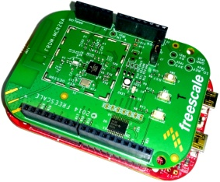

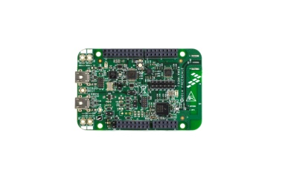
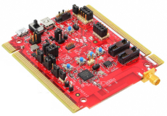
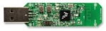

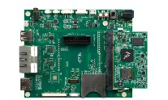
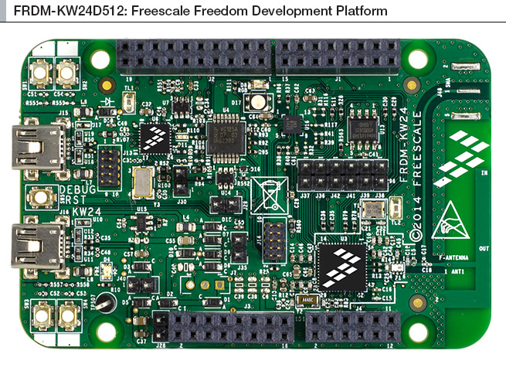
NXP Thread Hardware Offering
Kinetis KL46 + MCR20A Transceiver
Mesh Network End Device
Thread and IEEE 802.15.4 compliant
Freedom Board format
Runs FreeRTOS/MQX for Kinetis SDK
Kinetis KW2xD/Z
Border Router with RNDIS support
Mesh Network Router / End Device
Thread and IEEE 802.15.4 compliant
Tower Board, Freedom Board and USB Stick available
Runs FreeRTOS and MQX for Kinetis SDK
Kinetis K64F + MCR20A Transceiver
Border Router with Ethernet support
Mesh Network Router / End Device
Thread and IEEE 802.15.4 compliant
Freedom Board format
Runs FreeRTOS and MQX for Kinetis SDK
End Device
Thread Router
Leader
Border Router
Thread Link
i.MX6UL + FRDM-KW2xD/Z
Linux Border Router / Cloud gateway
Provides IP data routing and infrastructure integration
Runs Linux operating system
+

Slide 36
KL46 Thread End Device
Application
Thread Stack
SPI
KL46
MCR20
802.15.4 MAC/PHY
Memory is typical for Data Collector End node application
Kinetis L devices with 32K RAM can run 802.15.4 MAC/PHY,
Thread Network and Application as an End Node when paired with the MCR20A 2.4GHz Transceiver

Slide 37

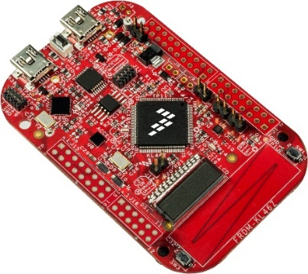
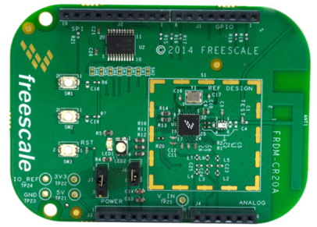
KLxx Combo Solutions
THREAD End Node
FRDM-KL46Z
FRDM-MCR20A

Slide 38
KW2xD Thread Border Router, Router and End Node
Application
Thread Stack
End Device
802.15.4 MAC/PHY
KW2xD/Z
Application
Router Device
Thread Stack
802.15.4 MAC/PHY
KW2xD/Z
End Device
Thread Router
Leader
Border Router
Thread Link
Application
Border Router
Thread Stack
802.15.4 MAC/PHY
KW2xD/Z
KW2xD/Z devices with 64K RAM can run as a Border Router, Router or End Device configurations with an Application.

Slide 39
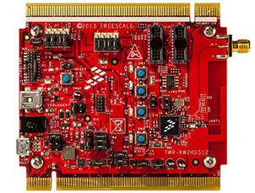
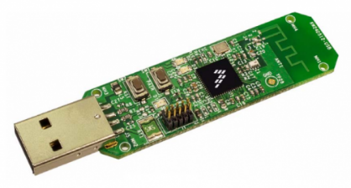
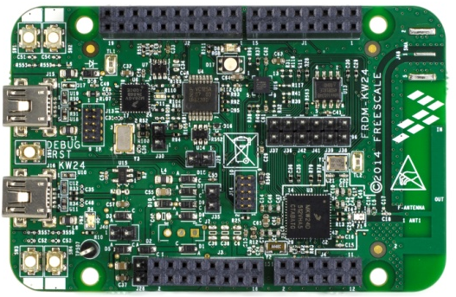
KW2xD Solutions
End Device / Router Eligible Device / Border Router
USB-KW2xD/Z
TWR-KW2xD
FRDM-KW2xD/Z

Slide 40
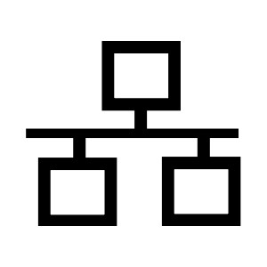
K64F Thread Border Router, Router and End Node
Application
SPI
End Device
Thread Stack
K64F
MCR20
802.15.4 MAC/PHY
Application
SPI
Router Device
Thread Stack
K64F
MCR20
802.15.4 MAC/PHY
End Device
Thread Router
Leader
Border Router
Thread Link
Ethernet
Application
Thread Stack
SPI
Border Router
K64F
MCR20
802.15.4 MAC/PHY
IPv4 or IPv6
Ethernet
K64 is standalone MCU with up to 1MB Flash, up to 256K RAM and embedded Ethernet
MCR20 is a 2.4GHz 802.15.4 transceiver

Slide 41
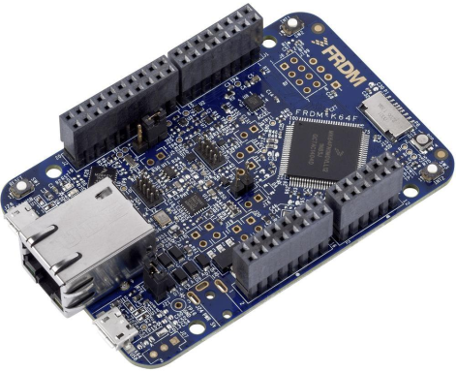

Kxx Combo Solutions
FRDM-K64F
FRDM-MCR20A
Thread Border Router
(Ethernet)
ETH
15.4

Slide 42
Linux Border Router (i.MX6 & KW2xD)
Linux System
Data
Management
USB
SPI
Events Processing
i.MX6
KW24D
Cloud
Connection
KW24D device runs the Thread Border Router functionality
i.MX6 Linux system handles Data Management and Analytics, Events Processing and Cloud Connection

Slide 43
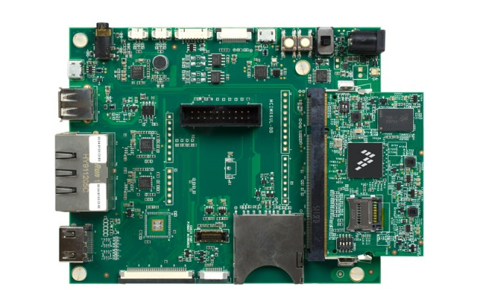
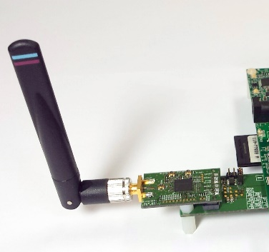
Linux Border Router Development Kit 2 months from start to prototype running Thread
i.MX6UL Eval Board
FRDM-KW24D512
Murata i.MX Dev Board
Linux Border
Router
(ETH, Wi-Fi)

Slide 44
NXP Thread Software

Slide 45
Links of interest
Kinetis Thread: www.nxp.com/Thread
Thread Group: www.threadgroup.org
KW2x: www.nxp.com/KW2x
TWR-KW2x: www.nxp.com/TWR-KWx
USB-KW24D512: www.nxp.com/USB-KW24D512
FRDM-K64F: www.nxp.com/FRDM-K64F
FRDM-KL46Z: www.nxp.com/FRDM-KL46Z
FRDM-CR20A: www.nxp.com/FRDM-CR20A
KinetisThread Extranet (download): www.nxp.com/go/ThreadBeta

Slide 46
Links of Interest
NXP Wireless Connectivity Community: https://community.freescale.com/community/wireless-connectivity
NXP Thread Community:
https://community.freescale.com/community/wireless-connectivity/content?filterID=contentstatus%5Bpublished%5D%7Ecategory%5Bthread%5D
Videos:
http://www.nxp.com/video/thread-smart-home-connectivity-demonstrations:FTF-THREAD-DEMO
http://www.nxp.com/video/freescale-thread-demo-with-alljoyn-application-framework:THREAD-DEMO

Slide 47

IDE
Currently supporting only IAR Embedded Workbench for ARM. Version 7.30.4 or later is required to deploy the sample applications.
Planning to add Kinetis Design Studio in 1H2016

Slide 48

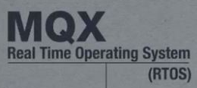
Supported RTOSes
The entire THREAD Network as well as THREAD applications are RTOS agnostic - can run over any supported RTOS without being aware about RTOS implementation details or even public API.
The abstraction is done via the OS Abstraction Layer (OSA). The current implementation of THREAD is using the Connectivity Framework OSA EXT layer, which in turns is using the Kinetis SDK OSA.
The latest THREAD release supports FreeRTOS and MQX

Slide 49
Thread Stack Overview – KW2xD
Customer Application (LWM2M, MQTT, etc)
Product Features:
Built on top of Kinetis SDK (1.2)
Multiple OS support via Kinetis SDK OSA
Thread stack successfully proven interoperability with other vendors.
Security
& App Layer
HTTPs
HTTP
DNS
CoAP
MLE
Stack Mgmt
Management Plane
SSL
TLS
DHCPv4
mDNS
DTLS
DHCPv6
Transport
& Session
BSD Sockets API
Bstrap and Commissioning
TCP
UDP
Network
IPv4
IPv6
Routing
Routing
ARP
ICMPv4
IGMP
ND
6LoWPAN-ND
ICMPv6
MPL (Trickle)
Software and Hardware
Evaluation & Dev Tools
Customer Application
PHY-MAC
Media Interfaces
6LoWPAN
Stacks
(TCP/IP, USB)
Middleware
Application Specific
WiFi
Enet
<1GHz - 802.15.4g
2.4GHz - 802.15.4
Thread Stack
NXP Border Router
Customer Supplied Components
Product Features:
Flexible, configurable and scalable Dual Stack IPv4 & IPv6 for constrained resources devices
Multiple interfaces support: 802.15.4 & 802.15.4g with 6LoWPAN, Ethernet and Wi-Fi
Designed for Low Power, Quick Wake-up Time and Low Memory footprint
OS Abstraction
Libraries
(DSP, Math, Encryption)
Operating System
BSP, Drivers & HAL
Bootloader
MCU Hardware

Slide 50
Thread Stack Overview – K64F
Customer Application (LWM2M, MQTT, etc)
Product Features:
Built on top of Kinetis SDK (1.2)
Multiple OS support via Kinetis SDK OSA
Thread stack successfully proven interoperability with other vendors.
Security
& App Layer
HTTPs
HTTP
DNS
CoAP
MLE
Stack Mgmt
Management Plane
SSL
TLS
DHCPv4
mDNS
DTLS
DHCPv6
Transport
& Session
BSD Sockets API
Bstrap and Commissioning
TCP
UDP
Network
IPv4
IPv6
Routing
Routing
ARP
ICMPv4
IGMP
ND
6LoWPAN-ND
ICMPv6
MPL (Trickle)
Software and Hardware
Evaluation & Dev Tools
Customer Application
PHY-MAC
Media Interfaces
6LoWPAN
Stacks
(TCP/IP, USB)
Middleware
Application Specific
WiFi
Enet
<1GHz - 802.15.4g
2.4GHz - 802.15.4
Thread Stack
NXP Border Router
Customer Supplied Components
Product Features:
Flexible, configurable and scalable Dual Stack IPv4 & IPv6 for constrained resources devices
Multiple interfaces support: 802.15.4 & 802.15.4g with 6LoWPAN, Ethernet and Wi-Fi
Designed for Low Power, Quick Wake-up Time and Low Memory footprint
OS Abstraction
Libraries
(DSP, Math, Encryption)
Operating System
BSP, Drivers & HAL
Bootloader
MCU Hardware

Slide 51
Freescale Serial Connectivity Interface (FSCI)
Allows interfacing the THREAD stack with a Linux or Kinetis host processor as well as with a PC tool using a serial communication line.
Can be used in two ways:
To test / debug THREAD stack functionalities.
As a communication protocol in a host - blackbox scenario.
Currently supported serial interfaces are: UART, USB, SPI and I²C.
The following types of messages are used by the THREAD FSCI:
Socket Messages (data plane)
Network Configuration Messages (management plane)
Network Utilities Messages (events and indications)
IP Tunnel Messages (available only for VTUN configuration)
THREAD Device
Host Processor / PC tool
FSCI
Serial Interface

Slide 52
Freescale Serial Connectivity Interface (FSCI)
The following types of messages are used by the THREAD FSCI:
Socket Messages (data plane)
Network Configuration Messages (management plane)
Network Utilities Messages (events and indications)
IP Tunnel Messages (available only for VTUN configuration)

Slide 53
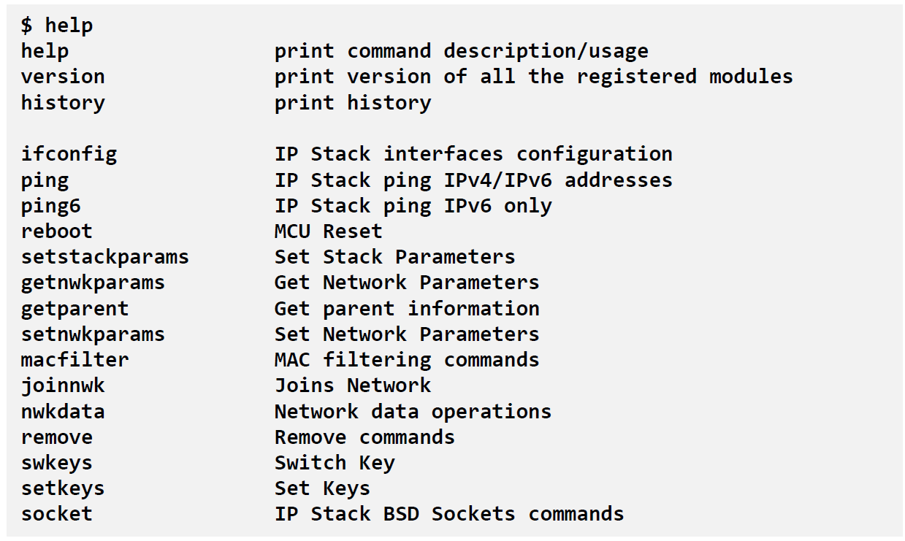
Connectivity Shell
The Shell module is offering a command line user interface over a serial interface, usually UART.
Implements a basic set of commands (not as many as FSCI does).
The commands can be viewed by typing the ‘help’ command in the host serial terminal application.
The Shell can be used for several purposes, including configuring the network, testing the network connectivity, MAC filtering, sockets usage and so on.

Slide 54
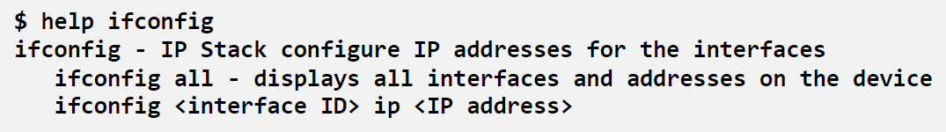
Connectivity Shell – cont.
In order to get help related to a particular command simply type ‘help’ followed by the command name:
All the shell commands description as well as usage examples are available in THREAD documentation release - THREAD Shell Interface User’s Guide.pdf

Slide 55
Kinetis Thread Stack – Number of Nodes per network
Nodes per network = Active Routers + End Devices (Router Eligible End Devices, Powered End Devices, Sleepy End Devices)
Number of Active Routers:
managed adaptively by Thread protocol
regularly 16-32 active routers in larger network depending on connectivity thresholds
maximum of 32 active router IDs specified by protocol
Number of End Devices:
Recommended number: 250 devices per subnet
Theoretical limit allowed by Thread specification: 16k devices
32 Active Routers
512 Children End Devices per Parent Active Router
Practical limit of Children depends on Parent memory capacity
Kinetis Thread Stack for KW24/KW22 default setting is 640 devices:
32 Active routers
20 Children per Parent, but can be increased with considering memory tradeoffs up to 50 Children

Slide 56
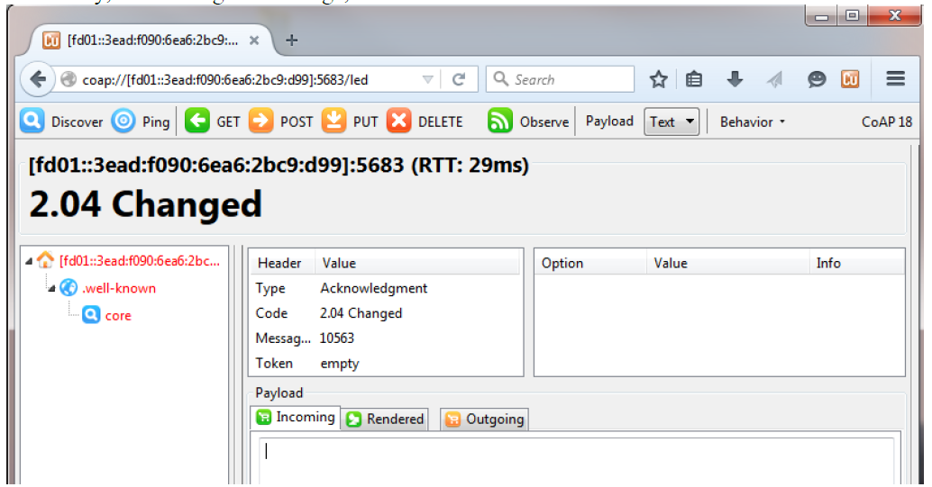
Availability of CoAP for Applications
All sample applications in Kinetis Thread Stack 1.0.x are based on CoAP for temperature monitoring, LED control, over-the-air updates
Thread protocol management framework (TMF) uses CoAP at the stack layer
Same CoAP framework available also to applications for better code footprint re-use

Slide 57

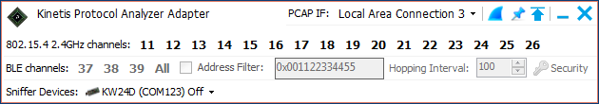
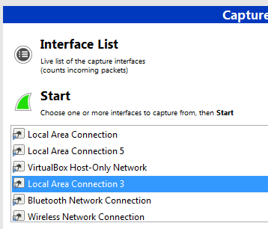
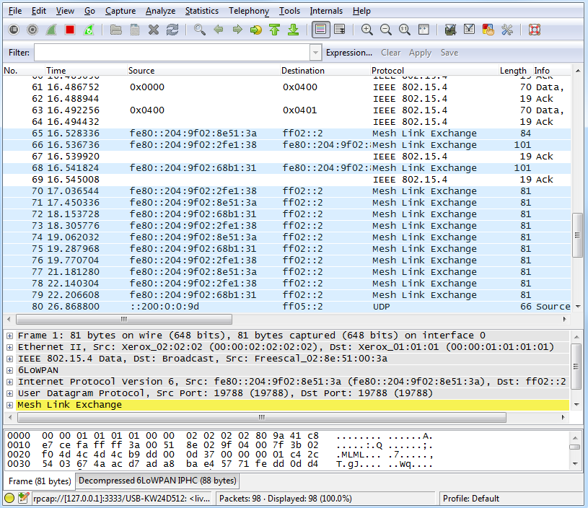

Sniffer with Wireshark + USB-KW24D512
Download and install the Kinetis Protocol Analyzer Adapter for USB-KW24D512
http://nxp.com/usb-kw24d512 -> Downloads Direct link
Download and Install Wireshark. Direct Link

Slide 58
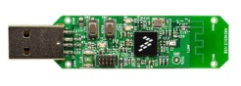

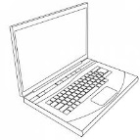


Border Router Options – Ethernet / THCI / RNDIS on Linux and/or PC
The border router is a device that provides connectivity of nodes in the Thread Network to other devices in external networks (LAN, Internet, VPN)
Current development package enables two starting points for Border Router development:
Thread Border Router app running on the FRDM-K64F + FRDM-MCR20A
Provides external IP connectivity through FRDM-K64F’s Ethernet port
Static route must be added to the connected PC in order to reach the Thread nwk
DHCPv6 from Thread router to the PC is not supported
Thread Host Controlled Device app (multiple boards supported)
Provides a Virtual Tunnel (VTun) interface that creates an IP layer link over the serial connection to a system running a high level operating system (Linux or Windows) through FSCI commands. See Kinetis-W Host API for Thread Stack.pdf
Thread RNDIS app (multiple boards supported)
Using the on-chip USB features of KW2xD to emulate a RNDIS “Ethernet over USB” emulated Network Interface Card for a PC running a host OS such as Windows. IPv6 capable applications running on the host will traverse the Thread network boundary to address Thread network devices end-to end at the IP layer.
+
Thread Border Router Thread Leader (Router) Thread Router Thread End Device (Sleepy device)
BR

Slide 59
Example usage of Thread with FSCI and TUN Driver in a Linux i.MX System Paired with Kinetis KW2x
IOT Gateway
Thread Router / End Node
IoT
Cloud
i.MX Linux System
FRDM-KW24D512
VTUN Border Router
TWR-KW24D512
End Node or Router
User Space
Network Manager
Commands
DHCPv6
MLE
Route
User Application
FSCI Linux Module
AirSync5 Agent
FSCI
Serial Manager
USB VCP Driver
DHCPv6
MLE
Route
IPv4 / IPv6 Packets
Socket Data
BSD Sockets
UDP
IPv6
BSD Sockets
UDP
IPv6
ttyACM0 (UART data)
Kernel Space
BSD Sockets
TCP
UDP
IPv6
IPv4
ICMP
ARP
IGMP
ND
6LoWPAN
802.15.4 MAC
802.15.4 PHY
VTUN
Media Interfaces
6LoWPAN
802.15.4 MAC
802.15.4 PHY
Media Interfaces
Linux USB VCP Driver
Ethernet
WiFi
Media Interfaces
TUN Driver
USB

Slide 60

Example usage of Thread with RNDIS
Host Device/OS
Thread & USB Enabled Kinetis Device, e.g.: KW2xD
End-to-End IPv6
Addressability to the
End Nodes
Host IP App
KW2xD Border Router App
Host IP Stack
Thread
Host
Control
Interface
Thread Core IP Stack
IP Layer 3 Forwarding
IPv6 Neighbor
Discovery
Thread IP
Forwarding
FD00::0001:
1233:8993:3113:9D4E
(SLAAC via ND, self
assigned)
FD00::3EAD:
A453:2344:8BC2:133A
(SLAAC via Thread,
self-assigned)
FD11:3992:1892:3113:
A453:2344:8BC2:133A
(Thread ML-EID)
FD00::3EAD:
0031:3891:313:87AB
(SLAAC via Thread, self
assigned, prefix received
via Thread Network
Data from Kinetis BR)
FD11:3992:1892:3113:
AD23:1330:1339:AB3E
(self assigned,
Thread Mesh Local-EID,
Prefix generated
by initial Leader)
FD00::0001:
A344:8311:D134:A56E
(SLAAC via ND, prefix
received via RA-RS sequence)
MAC: 00:41:11:21:13:33
MAC: 00:41:11:00:33:22:11
MAC: 00:41:11:21:13:34
(provided by RNDIS device side)
RNDIS
Media IF
6LoWPAN
Media IF
RNDIS Virtual
Host Interface
RNDIS USB
Device Stack
(subset of CDC)
UART/SPI
6LoWPAN over
IEEE 802.15.4
MACPHY
FD00::0001:: – Default Prefix set on the RNDIS link, generated and advertised by KW2xD as ND router
FD00::3EAD:: – Default “global” On-Mesh Prefix assigned by to the Thread subnet
FD11:3992:1892:3113:: – Randomized Mesh Local-only Prefix used on the Thread subnet

Slide 61
NXP Thread Demo Applications

Slide 62
Thread Demo Applications
Temp Sensor using CoAP
Sends temp when button is pressed
Data encoded using a CoAP frame format at the application layer
Sent over UDP at the transport layer
Data Sink using CoAP
Set a node to announce itself as an application Data Sink – representing a single concentrator destination node on the network for application messages
All CoAP confirmable commands addressed to the Data Sink node will be stored there
Set a node to announce releasing (ceasing) the Data Sink role
Control RGB LED on FRM Board using CoAP
Uses board button switches to send an LED ON or LED OFF command to the other devices on the Thread network
The LED control command is:
encoded using a CoAP frame format at the application layer
carried over UDP at the transport layer
multicast using the <All Thread Nodes> realm-local multicast destination address at the IPv6 layer indicating it should be passed on to all nodes
passed through via 6LoWPAN and MPL by the upper IPv6 protocol stack to and from the link layer
broadcast over-the-air at the link layer for all non-Low Power End Device destinations
unicast over-the-air at the link layer on a MAC Data Request poll sequence for Low Power End Device destinations by the Routers which are respective parents of the End Devices

Slide 63
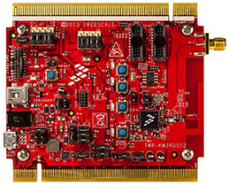
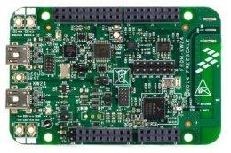
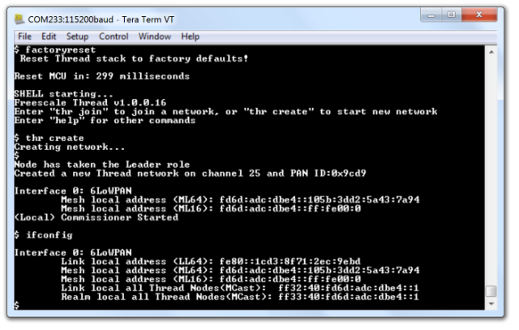
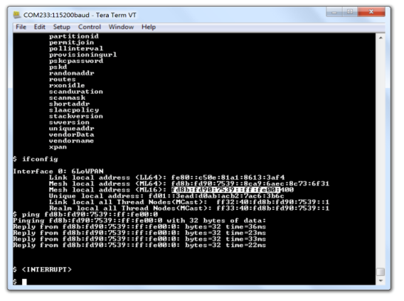
Kinetis Embedded Demos for Self Contained Networks
Router Eligible Devices
REED or End Node or
Low-Power End Node
CLI interface for REED and End Nodes
Human readable commands implemented for network creation, commissioning, configuration, testing
Push button demo to send Node temperature multicast to all nodes
Simple push button lighting demo.
CLI interface for REED and End Nodes
Human readable commands implemented for setup nodes for commissioning, join network, network configuration, testing
Push button demo to send Node temperature multicast to all nodes
Simple push button lighting demo.

Slide 64
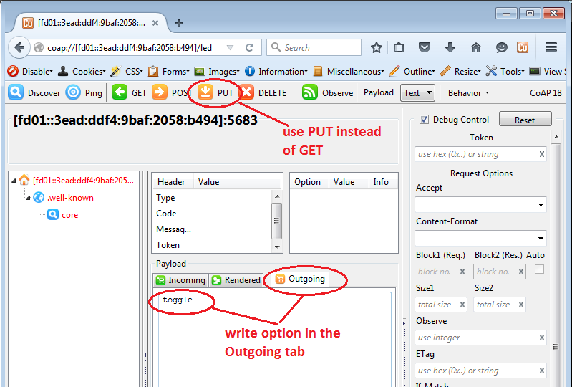

Kinetis Ethernet Border Router – Out of Box Demos
K64F + MCR20A
Ethernet Border Router
or
KW2x USB RNDIS
Border Router
KW2x REED or End Node
Communicate with Thread devices from Windows via Ethernet or USB RNDIS interfaces
CoAP (get/post) examples for remote temperature and LED control/toggle using Copper Firefox add-on
CLI interface for REED and End Nodes
Human readable commands implemented for network creation, commissioning, configuration, testing
Push button demo to send Node temperature multicast to all nodes
Simple push button lighting demo.

Slide 65
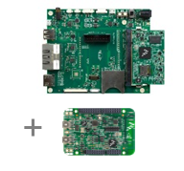
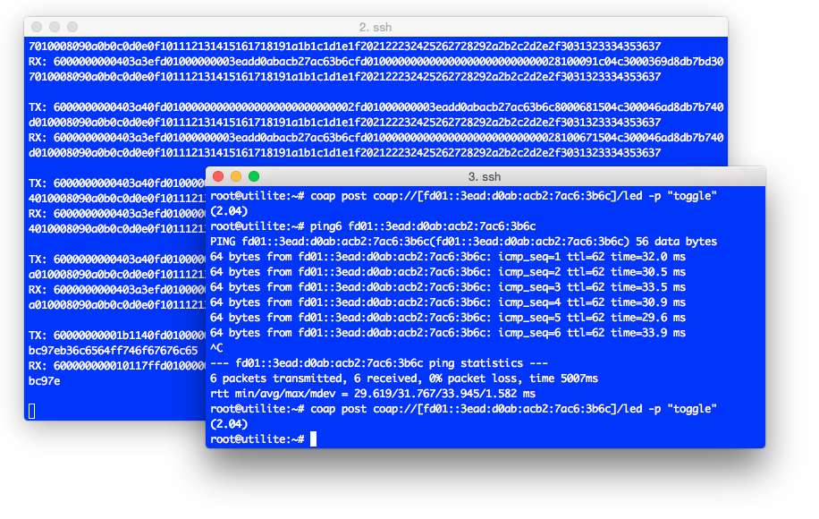
i.MX6 Linux Border Router + THCI – Out of Box Demos
i.MX6 Yocto Linux
FRDM-24x THCI
KW2x REED or End Node
Linux Host control interfaces
C and Python Based Virtual TUN Tap drivers for IPv6 packet routing
Commissioning example code
CoAP (get/post) examples for remote temperature and LED control/toggle
CLI interface for REED and End Nodes
Human readable commands implemented for network creation, commissioning, configuration, testing
Push button demo to send Node temperature mutlicast to all nodes
Simple push button lighting demo.

Slide 66
Thank You!

Slide 67
Backup

Slide 68
Silicon block diagrams

Slide 69
In Full Production - MKW2xD
Core Features
50 MHz Cortex M4 CPU core
Up to 512KB Flash & up to 64KB SRAM
Typical current: 250 uA/MHz run, 1.7uA RTC standby
RF Features
2.4 GHz frequency ISM band, including MBAN
-102dBm receive sensitivity
Up to + 8dBm programmable output power
TX 17mA at 0dBm and RX 19mA typical
Cryptography: DES, 3DES, AES 128-256, SHA-1, SHA-256, MD5, RNG
Active and passive tamper detection
Dual-PAN support (personal area network)
Fast antenna diversity supporting 2 antennas
Low component count for Balun & Match
System Features
-40 °C to 105 °C
1.8 to 3.6 V
8x8 Laminate QFN 63-pin
Core
System
Memories
RF Transceiver
ARM CortexTM-M4
50 MHz
Internal and External Watchdogs
Program Flash
(Up to 512 KB)
IEEE 802.15.4 2006
2.4 GHz
DSP
DMA
FlexMemory Option
64 KB FlexNVM
4 KB FlexRAM
(MKW21D256 only)
Fast Antenna Diversity
Low Leakage Wake-Up Unit
Debug Interfaces
Dual PAN ID
Interrupt Controller
Analog
SRAM
(Up to 64 KB)
32 MHz Osc
16-bit ADC
SPI Interface
Communications
High Speed Comparator with
6-bit DAC
Timers
I²C
Flex Timer
Clocks
SPI
Security
Programmable Delay Block
Phase-Locked Loop
UART (ISO 7816)
Cyclic Redundancy Check (CRC)
Periodic Interrupt Timers
Frequency Locked Loop
USB On-The-Go (H)
Tamper Detect
Cryptography Authentication Unit
Low Power Timer
Low / High Frequency Osc.
USB Charger Detect
USB Voltage Regulator
Random Number Generator
Independent Real Time Clock
Internal Reference Clocks
High performance 2.4 GHz 802.15.4 transceiver
Notes:
Freescale Semiconductor’s second-generation ZigBee® compliant platform combines an IEEE® 802.15.4-compliant radio and an 8-bit MCU into a 9 x 9 x 1 mm 64-pin LGA package
The MC1321x Family encompasses a series of devices that are memory scalable to fit the needs of the application. Each device includes a Freescale MC9S08GT-based MCU with up to 60 KB of Flash and 2.4 GHz 802.15.4 transceiver.
Regardless of the application’s requirements, which may range from simple point-to-point connectivity to ZigBee mesh networks, the MC1321x devices scale to meet them.

Slide 70
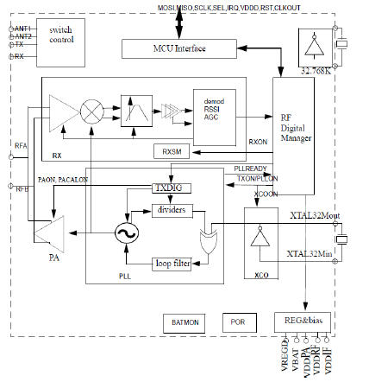
In Full Production - CR20x High Performance 2.4GHz 15.4 Transceiver
RF Features
High performance 2.4 GHz IEEE 802.15.4 RF transceiver
Packet processor for hardware acceleration
Supports single ended and diversity antenna options
Dual PAN support
-30 to + 10 dBm power output
-102 dBm sensitivity
TX 15mA @ 0dBm (CPU sleep)
RX 15mA (CPU sleep)
AES Hardware encryption/decryption
True Random Number Generator
SPI Interface (memory mapped)
6 GPIO
System Features
-40°C to 125°C
1.8 to 3.6 V
5x5 32-pin LGA
Samples – Q3 2012, Production – Q1 2013
High performance 2.4 GHz 802.15.4 transceiver
Notes:
Freescale Semiconductor’s second-generation ZigBee® compliant platform combines an IEEE® 802.15.4-compliant radio and an 8-bit MCU into a 9 x 9 x 1 mm 64-pin LGA package
The MC1321x Family encompasses a series of devices that are memory scalable to fit the needs of the application. Each device includes a Freescale MC9S08GT-based MCU with up to 60 KB of Flash and 2.4 GHz 802.15.4 transceiver.
Regardless of the application’s requirements, which may range from simple point-to-point connectivity to ZigBee mesh networks, the MC1321x devices scale to meet them.

Slide 71
Kinetis L – KL46
Core
System
Memories
Clocks
Packages
121MAPBGA 8x8x1.4/0.65mm
100LQFP 14x14x1.4/0.5mm
64LQFP 10x10x1.4/0.5mm
64MAPBGA 5x5x1.23/0.5mm
Features Highlight
USB OTG
Touch sensor interface
High pin count
Availability
Production Now
ARM Cortex-M0+
48MHz
Direct Memory Access
Flash
128-256KB
Low & High Frequency
Oscillator
Single Wire Debug
Micro Trace Buffer
Power Management Controller
SRAM
16-32KB
Internal Reference Clocks 4MHz/32KHz
Interrupt
Controller
Low-Leakage Wakeup Unit
Bit Manipulate Engine
Register File
32B
Low Power Clock 1KHz
Watchdog
PLL&FLL
Security
Analog
Timers
Communication Interfaces
Human
Machine
Interface
Flash Security
max 20ch
16-bit SAR ADC
1x 6ch
Low Power Timer/PWM
1x Low Power UART
USB FS OTG
max 84 GPIOs
with 46 Interrupts and 4 High Drives
High Speed Analog Comparator
2x SPI
USB Voltage Regulator
2x 2ch
Low Power Timer/PWM
2x IIC
Serial Audio Interface/I2S
12-bit DAC
Low Power Timer
2x UART
max 51x8/55x4 Segment LCD
2ch Periodic
Interrupt
Timers
16ch Touch Sensor Interface
Real Time Clock

Slide 72



Kinetis K64F
(up to 1 MB Flash)
Learn More:
Kinetis K6x Fact Sheet
Kinetis K Selector Guide
Kinetis K Kill sheets (CIA)
K64 120MHz Public Website
‘K2’ Next Generation
Portfolio Scalability
CPU Performance
Static/Dynamic Low Power
Crystal-less USB
FlexIO
Tamper Detection
LP Trusted Crypto
Memory Interfaces
Extended SRAM
Asynchronous DMA
Smarter Peripherals
FlexMemory / EEPROM
Program Flash Security
Boot ROM
Quad SPI XIP
Separate Voltage Domain
Large I/D Cache
VBAT Voltage Range
Enablement Tools
Block Diagram
Core
System
Memories
Clocks
Key Product Features
ARM Cortex-M4F
120MHz
Internal and External
Watchdogs
Program Flash
Up to 1MB
FlexMemory
128KB
Phase-Locked
Loop
Key Product Features
Serial Programming
Interface
(EzPort)
FlexBus
External
Bus
Interface
Frequency-
Locked Loop
Debug
Interfaces
DSP
DMA (16ch)
Interrupt
Controller
FPU
Low-Leakage
Wake-Up Unit
Low/High
Frequency
Oscillators
SRAM
Up to 256KB
Memory Protection Unit (MPU)
Internal
Reference
Clocks
Security
and Integrity
Analog
Timers
Communication Interfaces
HMI
2 x16-bit ADC
FlexTimer
3xI²C
1xI²S
GPIO
Cyclic
Redundancy
Check (CRC)
3 x ACMP
Programmable Delay Block
UART
(Up to 6)
USB OTG
(LS/FS)
Random Number Generator
Periodic Interrupt Timers
12-bit DAC (Up to 2)
3xSPI
USB
Device Charge Detect (DCD)
Cryptographic Acceleration unit
Vref
Low-Power
Timer
1xCAN
Enhanced SDHC
Independent
Real-Time
Clock (RTC)
IEEE 1588 Ethernet MAC
Carrier Modulator Transmitter
Links to:
Standard Feature
Optional Feature

Slide 73
i.MX 6UL-3 Processor
Specifications
Process: TSMC 40LP
Core Voltage: 1.1V
Package:
289 MAPBGA (14x14, 0.8 mm pitch)
289 MAPBGA (9x9, 0.5mm pitch)
Temperature:
Consumer: 0C to 95C (Tj)
Industrial: -40C to 105C (Tj)
Key Features and Advantages
ARM Cortex-A7 @ 528 MHz, 128 KB L2 cache
LCD Display up to WXGA (1366x768)
8-bit/10-bit/16-bit Parallel Camera Sensor Interface
16-bit LP-DDR2, DDR3/LV-DDR3
16-bit Parallel NOR FLASH / PSRAM
Dual-channel Quad SPI NOR FLASH
8-bit Raw NAND FLASH with 40-bit ECC
2x MMC 4.5/SD 3.0/SDIO Port
2x USB 2.0 OTG, HS/FS, Device or Host with PHY
Audio Interfaces include I2S/SSI, S/PDIF Tx/Rx
10/100 Ethernet with IEEE 1588 x 2
Security Block: TRNG, Crypto Engine (AES with DPA, TDES/SHA/RSA), Tamper Monitor, Secure Boot, SIMV2/EVMSIM X 2, OTF DRAM Encryption, PCI4.0 pre-certification
Partial PMU Integration
Enablement
Linux BSP from Freescale
i.MX 6UL-3
System Control
Connectivity
Secure JTAG
CPU Platform
eMMC 4.5 / SD 3.0 x2
PLL, OSC
ARM Cortex-A7
NAND Ctrl (BCH40)
RTC & Reset
32 KB I-cache
32 KB D-cache
UART x8
Smart DMA
NEON
PTM
IOMUX
128 KB L2-cache
SIM V2/EMVSIM x2
Timer x4
I2C x4
PWM x8
Multimedia
SPI x4
Watch Dog x3
CSC, Combine, Rotate,
Programmable Proc. Engine
GPIO
Power Mgmt
8x8 Keypad
LDO
16-bit Parallel CSI
I²S/SAI x3
Temp Monitor
24-bit Parallel LCD
S/PDIF Tx/Rx
ADC
External Memory
ASRC
ADC x2 (10-ch)
w/ touch ctrl
Parallel NOR FLASH
FlexCAN x2
Internal Memory
Dual-Channel Quad SPI x1
10/100 ENET x2
with IEEE 1588
96 KB ROM
16-bit LP-DDR2/DDR3/DDR3L
128 KB RAM
USB2 OTG w/ PHY x2
Security
Ciphers
RNG
eFuse
Secure RTC
OTF DRAM Encryption
10 Tamper Pins
RSA4096 DPA protection
32KB Secure Storage
Notes:
Product Directive targets are initially approved during entry to Concept phase, updated and locked at the end of Planning
Lifetime Volume: OSW Finance summary
Lifetime Revenue: OSW Finance summary (Includes NRE and Royalty)
Gross Margin: OSW Finance Summary or Division estimation
Development cost: OSW Finance summary or Division estimation
ROI? : Not clearly defined in OSW Finance Summary, so Division estimation, PBT$ / Total Cost is not right as done by MSG
Product Cost components: OSW Cost Model (actual package cost, not yielded cost?)
Schedule: Product Management to determine this, initial sales in OSW should be post Factory certification (or qualification) date.
Definitions of Functional etc per new NPI process, Divisions to stick to this.
Manufacturing Technology components: OSW Cost Model
New IP, Re-use: Determined by Product Management

Slide 74
Broadcom / Murata details

Slide 75


i.MX WiFi & Bluetooth Strategy
3 companies partnering to deliver world-class solutions for connected products
+
+
Leading Micro-processor
Solutions with i.MX products
#1 market share for WiFi &
Bluetooth IC
#1 market share for WiFi &
Bluetooth modules
Out-of-box processor and wireless connectivity for Linux and Android based systems
Wi-Fi (802.11bgn, abgn, abgn/ac) & Bluetooth Smart Ready Options

Slide 76

Murata Kit Interconnect with Freescale EVK’s
i.MX6SX Sabre SoloX
Murata i.MX InterConnect
+
Type ZP EVB
2.4/5.0 GHz Antenna
(Dual-Band)
Murata Custom Interconnect for Freescale
SDIO to 60PIN Adapter => Provides Wi-Fi SDIO/BT UART connection
Murata Type ZP EVB (BCM4339)

Slide 77
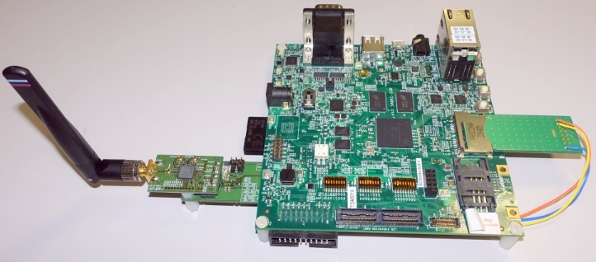
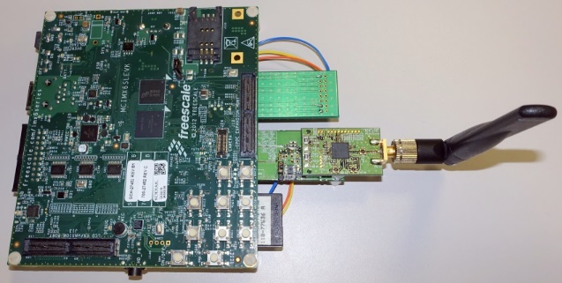
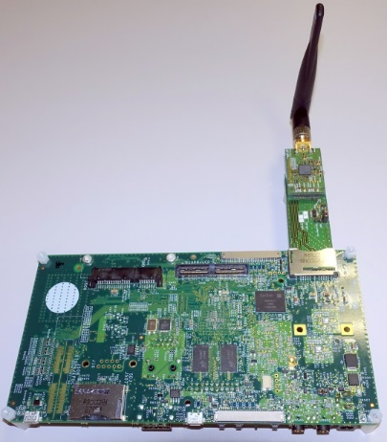
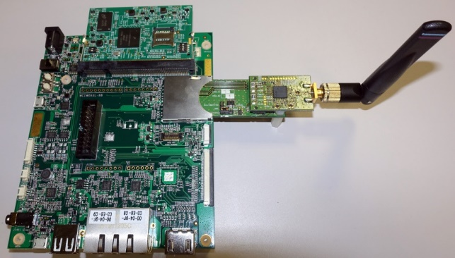
i.MX6 Platforms + Murata Wi-Fi/BT Dev Kits
i.MX 6SoloX +
Ver 1.0 & SD Card Ext
i.MX 6SoloLite +
Ver 1.0 & SD Card Ext
i.MX 6Quad SABRE + Ver 2.0
=> ONLY Modified Board
i.MX 6UltraLite + Ver 2.0

Slide 78
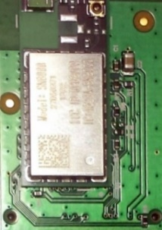
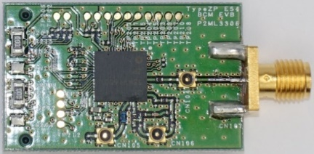
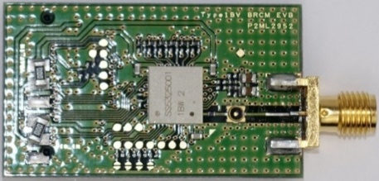
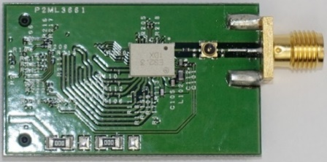
Murata Development Kits
Type ZP | Type 1BW | Type 1DX | Type 1FX | SN8000 FCC/CE/IC CERTIFIED
BCM4339 | BCM43340 | BCM4343W | BCM43364 | BCM43362
802.11a/b/g/n/ac BT/BLE | 802.11a/b/g/n BT/BLE | 802.11b/g/n BT/BLE | 802.11b/g/n (Wi-Fi Only) | 802.11b/g/n (Wi-Fi Only)
7.8 x 7.4mm H: 1.0mm | 8.0 x 7.5mm H: 1.1mm | 6.95 x 5.15mm H: 1.1mm | 6.95 x 5.15mm H: 1.1mm | 24 x 11.4mm H: 1.9mm

Slide 79
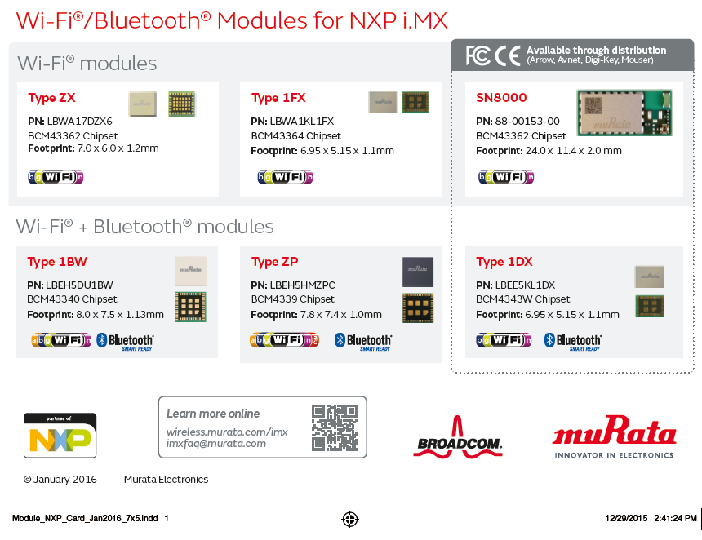

Slide 80
Supported Freescale Boards & Murata Modules
Reference Board | SN8000 | ZX | 1FX | 1BW | 1DX | ZP
i.MX6 SABRE board for Smart Devices | Supported | Supported | Supported | Supported | Supported | Supported
i.MX 6 Solo Lite EVK | Supported | Supported | Supported | Supported | Supported | Supported
i.MX6 SABRE Platform for Smart Devices | Supported | Supported | Supported | Supported | Supported | Supported
i.MX6 SABRE for Automotive | Supported | Supported | Supported | Supported | Supported | Supported
i.MX6 UL EVK | Supported | Supported | Supported | Supported | Supported | Supported

Slide 81
Murata Development Kits Details & Availability
The Murata modules are orderable now at Mouser, Arrow and Avnet
Part | Chipset | WLAN | BT | Mouser | Arrow | Avnet
Type ZP | BCM4339 | 802.11b/g/n.ac | v4.0+EDR | ZP | ZP | ZP
Type 1BW | BCM43340 | 802.11a/b/g/n | v4.0+EDR | 1BW | 1BW | 1BW
Type 1DX | BCM4343W | 802.11b/g/n | v4.1 | 1DX | 1DX | 1DX
Certified Module
SN8000 | BCM43362 | 802.11b/g/n | No | SN8000
1FX Dev kits are currently in development and will be available in February 2016

Slide 82
Software, Support
The current Linux and Android BSP’s 3.14.52 and L5.1.1 have native support for all Murata modules based on Broadcom chipsets
The Broadcom firmware is not included in the Linux 3.14.52 BSP but can be downloaded separately here - build instructions are included
Freescale FAE/Technical support:
Patch files and all documentation are posted on Freescale Community Murata/i.MX at: https://community.freescale.com/groups/murata-imx -users have to join the community and request access as this is currently a private space.
Broadcom documentation is posted at: http://community.broadcom.com/groups/freescalemuratabroadcom-imx-support-portal
To gain access:
1) Register on the main community here: http://community.broadcom.com/login.jspa?registerOnly=true
2) Email your User ID to skerr@murata.com – he will grant access
Questions can also be asked at: imxFAQ@murata.com – this is monitored by Murata
Murata also have a dedicated landing page : i.MX/Murata

Slide 83
Murata Sales Contacts
COUNTRY | CITY/AREA | MANAGER | PRIMARY CONTACT | EMAIL | MOBILE | OFFICE
USA | San Jose | Mehul Udani | Keith Koyama | kkoyama@murata.com | *1 (408) 893-2358 | *1 (408) 392-1397
USA | Dallas | Mehul Udani | Tony Garcia | tgarcia@murata.com | *1 (214) 662-1391 | *1 (972) 248-2043
USA | Dallas | Mehul Udani | Wilson Lee | wlee@murata.com | *1 (972) 854-2328 | *1 (972) 931-7463
USA | Atlanta | Mehul Udani | Steve Kim | skim@murata.com | *1 (678) 848-8930 | *1 (770) 319-5149
USA | Distribution | Mehul Udani | Ghouse Mohiuddin | ghouse.mohiuddin@murata.com | *1 (214) 478-8037 | *1 (972) 789-3824
CHN | CHN-Shanghai |  | Evan Jing | evan.jing@murata.com |  | *86 (021) 32054626 EXT 229
CHN | CHN-Shenzhen | Terry Lo | Frank Liu | frank.liu@murata.com
TWN | TWN | Vincent Feng | Ken Wang | ken.wang@murata.com | *866 0977-409-553
ASEAN | ASEAN | Gary Han Wee Kwang | Kohta Nakai | kohta.nakai@murata.com | *65 9630 7551
INDIA | INDIA |  | Vishwas BN |  | *91 (990) 090-5324 | *91 (990) 090-5324
KOR | KOR | Hiroyasu Matsuzaki | Jung Min Hong | jungmin.hong@murata.com | *82 (10) 7186-2347 | *82 (2) 3016-3373
JPN | JPN |  | Hiroshi Ogata | hogata@murata.com
EU | IOT | Mac Tochigi | Rui Ramalho | rramalho@murata.com | *31 (0) 6 46 29 39 00 | *31 (0) 23 56 98 414
EU | IOT | Mac Tochigi | Jiro Morinaga | jmorinaga@murata.com
EU | Automotive | Mac Tochigi | Thomas Widmer | twidmer@murata.com

Slide 84
Murata Dev Kits Details

Slide 85
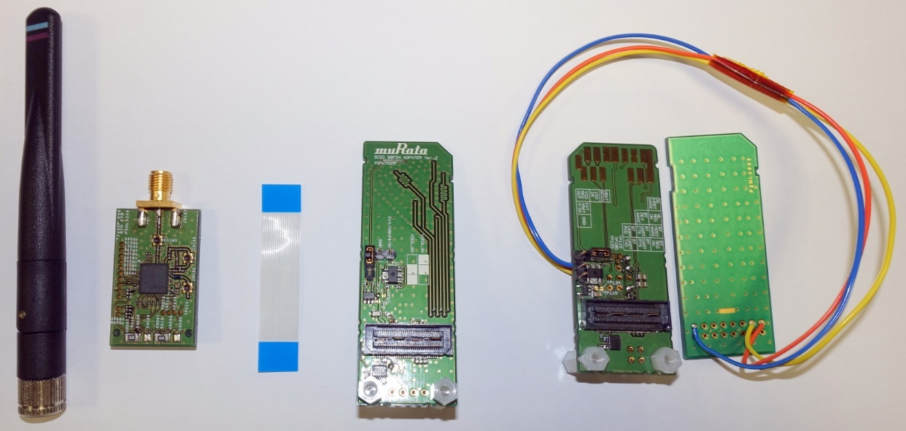
Murata Wi-Fi/BT Dev Kits Details
Antenna
Murata Wi-Fi/BT EVB
Ver 2.0 Adapter
Ver 1.0 Adapter & SD Card Extender Pre-Wired
Ver 1.0 Adapter Configuration Changed to disable power-on-reset BT_REG_ON/WL_REG_ON
WL_REG_ON/WL_HOST_WAKE/BT_REG_ON pre-wired to SD Card Extender (SD_DAT1, SD_DAT2, SD_DAT3)
Ribbon Cable

Slide 86
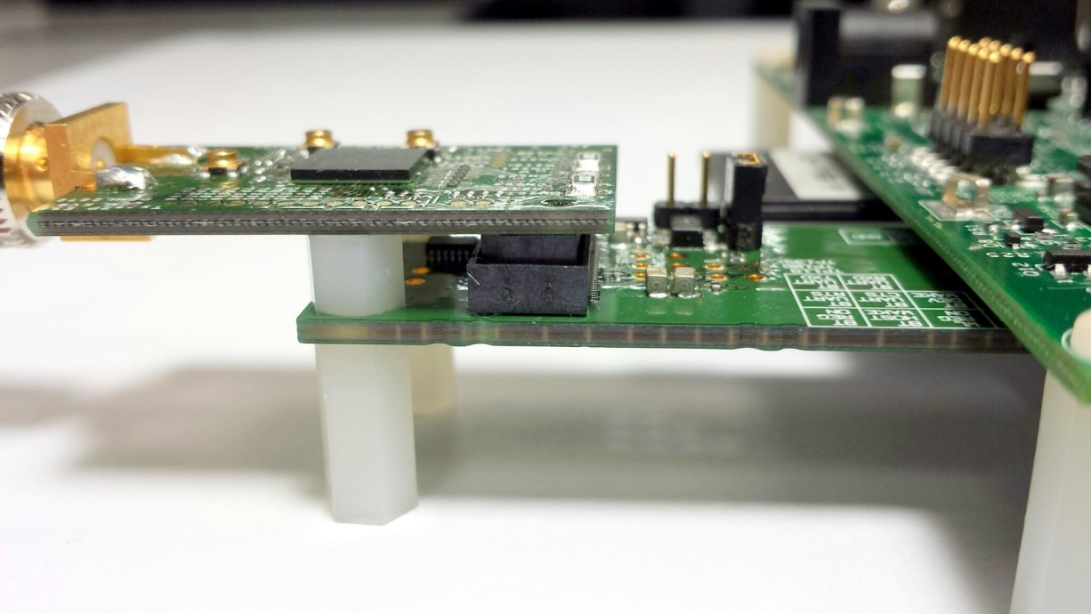
i.MX 6SX Sabre SoloX + Type ZP EVB
i.MX 6SX Sabre SoloX
SMA Rigid RF Threaded Connector
Murata Type ZP EVB (BCM4339)
Rigid 60-pin Samtec Connector
Murata i.MX InterConnect => Provides Wi-Fi SDIO/BT UART connection
Nylon HEX Standoffs provide secure support

Slide 87
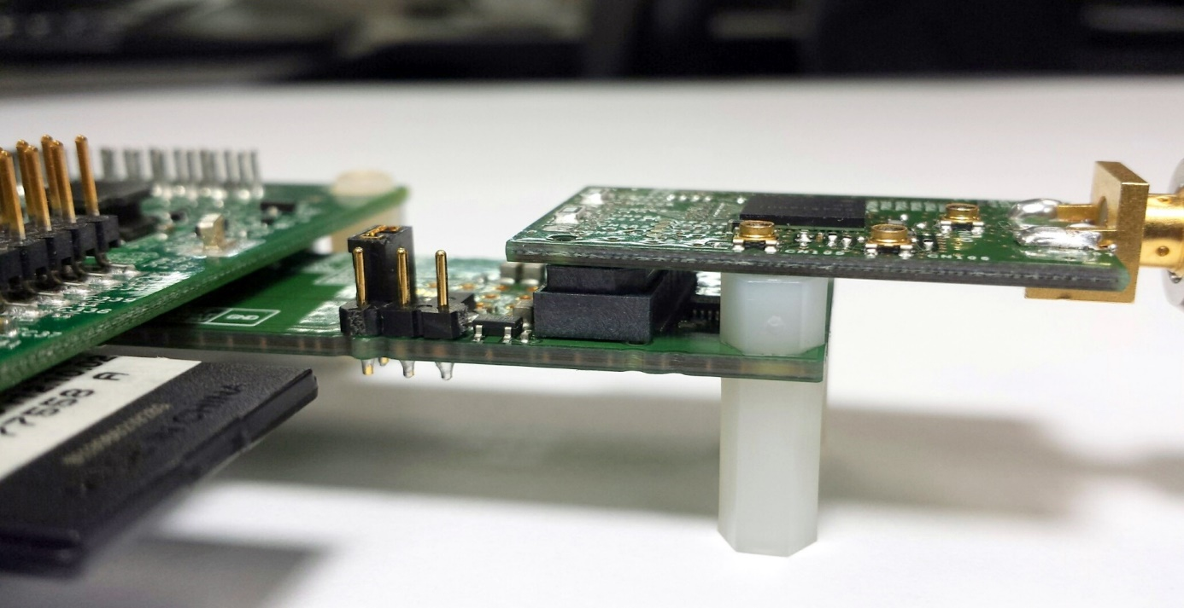
i.MX 6SX Sabre SoloX + Type ZP EVB
VIO_IN Jumper Select: 1.8V or VBAT_SDIO
Optional VEXT (4.0V-5.0V) Allows Customer to measure current consumption of Wi-Fi/BT – useful when working on optimization
Standoff between Adapter and EVB: supports EVB for probing test points

Slide 88
High Level Hardware InterConnect Overview
Freescale i.MX 6 EVK
Murata
Wi-Fi/BT
EVB:
ZP/1BW/1DX/
1FX/1FJ/
SN8000
WLAN SDIO
BLUETOOTH
Murata i.MX Interconnect
Murata i.MX InterConnect
HCI H4-UART
Optional
WLAN/BT On-Off OOB IRQ

